Slide 1
WMHA/LMHA Amalgamation
March 20, 2024

Slide 2
Meeting Agenda
Pillars of Success for New Association
House League Program
Team Creation
Programming Locations
Travel Program
Team and Coach Selection Process
Proposed Program Structure
Programming Locations
Q&A Session
Team Composition
Philosophy

Slide 3
Pillars of Success for New Association
Focus on Fun and Development
Being a good sport
Safety
Fairness
Inclusion
Respect

Slide 4
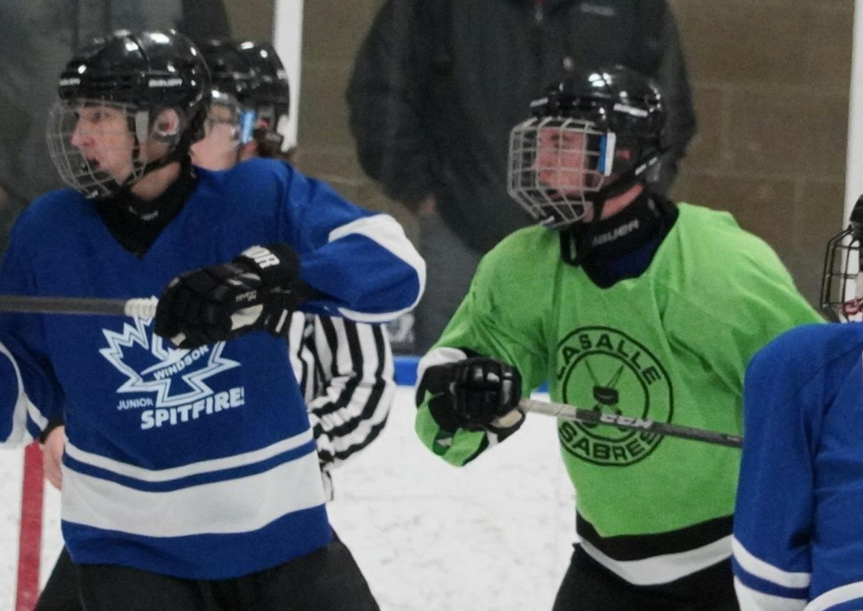
House League Programming
Philosophy: to provide programming that creates a love of hockey from the first shift to the last shift in a child’s minor hockey experience.
How Will We Do This?
Create programming based on the association’s pillars of success;
Provide access to age-appropriate development activities throughout the season;
Offer special events and experiences to connect teams and to develop relationships within the association;
Work to remove barriers to participation for players and their families

Slide 5
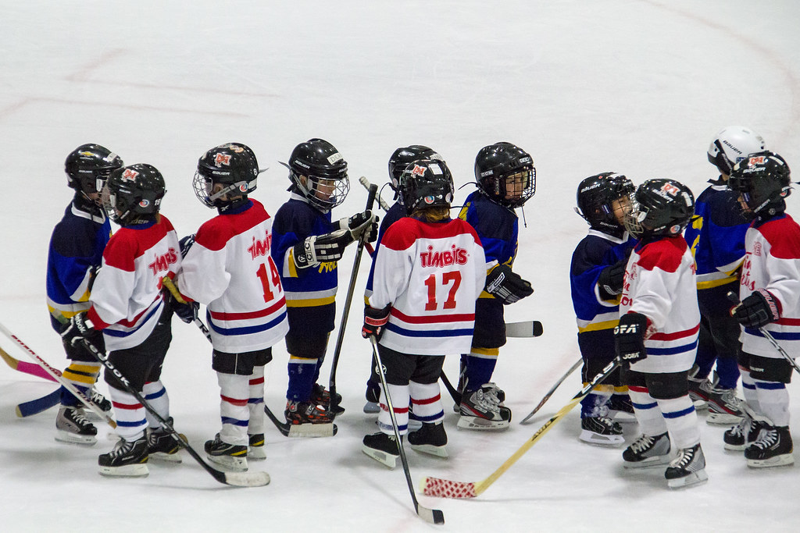
House League Programming
Team Creation – there are two options for consideration
East and West divisions;
Fully blended house league programming
Recommended Year 1 Path
To establish East and West Divisions for Year 1 in order to survey the membership to further understand concerns and barriers to participation

Slide 6
Travel Programming
Philosophy: to provide competitive hockey programming that gives players the mental and physical skills to compete for roster spots on higher level hockey teams while providing players a memorable experience
How Will We Do This?
Create programming based on the association’s pillars of success;
Establish relationships with local area AAA centers and Junior teams
Create a fair process for player tryouts that aims to place players at the correct level in order to compete physically and mentally;

Slide 7
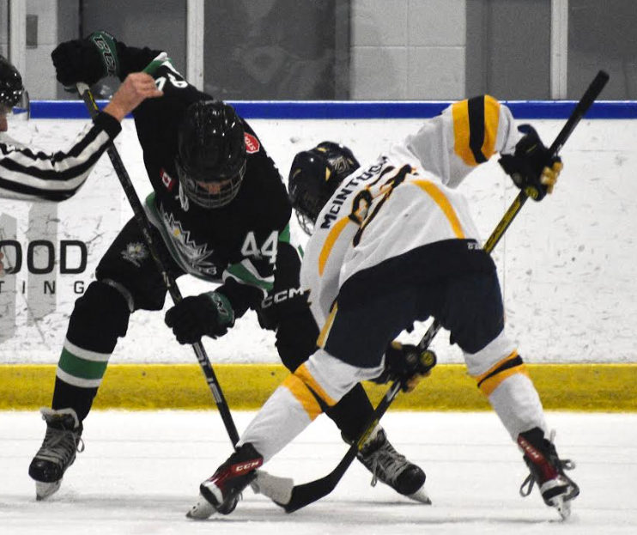
Travel Programming
Coach Selection and Programming Locations
Year 1 coach and team selection will be a combined effort including representatives from WMHA and LMHA along with independent third party evaluators.
Further membership engagement will assist to create formalized policies regarding team and coaching selection. In keeping with the Pillars of Success, the goal will be to provide fair, inclusive opportunities for all players. An aim of the travel coach selection process will be to recruit qualified non-parent coaches at as many age groups as possible.
Travel teams would primarily play at Vollmer and Central Park Athletics. Practices would be between CPA, Adie Knox and Vollmer.

Slide 8
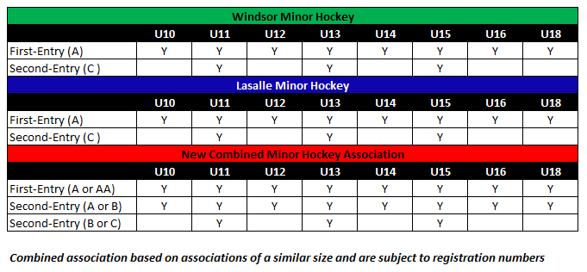
Team Composition

